Slide 1
PIM – Phase 1
Team Members:
Jessica Fealy - 18024092
Eduard Tenev - 18068235
Komal - 30010813
Harry Pearce - 18136044
Ben Harrison - 18142915

Slide 2
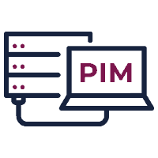





What we are doing
As a personal information management team our task is to develop a program with graphical user interface with python.
The program will be used from staff members mainly from company management where they will have to login using their credentials to gain access to staff database. There they will have the option to search, create or update details for staff members.
The program also will include security protection to block unauthorised access and prevent potential data breaches.
Eduard Tenev - 18068235

Slide 3

Tasks Completed
Trello
Github
LESPI
GUI Designs
Tkinter Research
Flowcharts
Quality Assurance Doc
SQLite Research
Harry Pearce – 18136044

Slide 4

Quality Assurance – Design and Installation
I work some parts of quality assurance that ensure the application design and installation easy. I pointing out some main design that we need to achieve before polish the finish product. I made a specific point for design that make thing easier for GUI designer simple.
Harry Pearce – 18136044

Slide 5

Quality Assurance – Database
As a team we decided to use SQLite database management software. Why we choose this software is because is a free open source so we don’t need commercial licence to use it. It is very light in comparison with other database management systems . It can be used on a broad range of platforms such as Windows, Mac OS, Linux and Unix. And not on the last place the SQLite database is contained on a single file on the computer disc storage with all the database objects included in the file and removes the need of dedicated server.
The data set for our database will be provided by our project manager Shaily Jain.
Eduard Tenev - 18068235

Slide 6
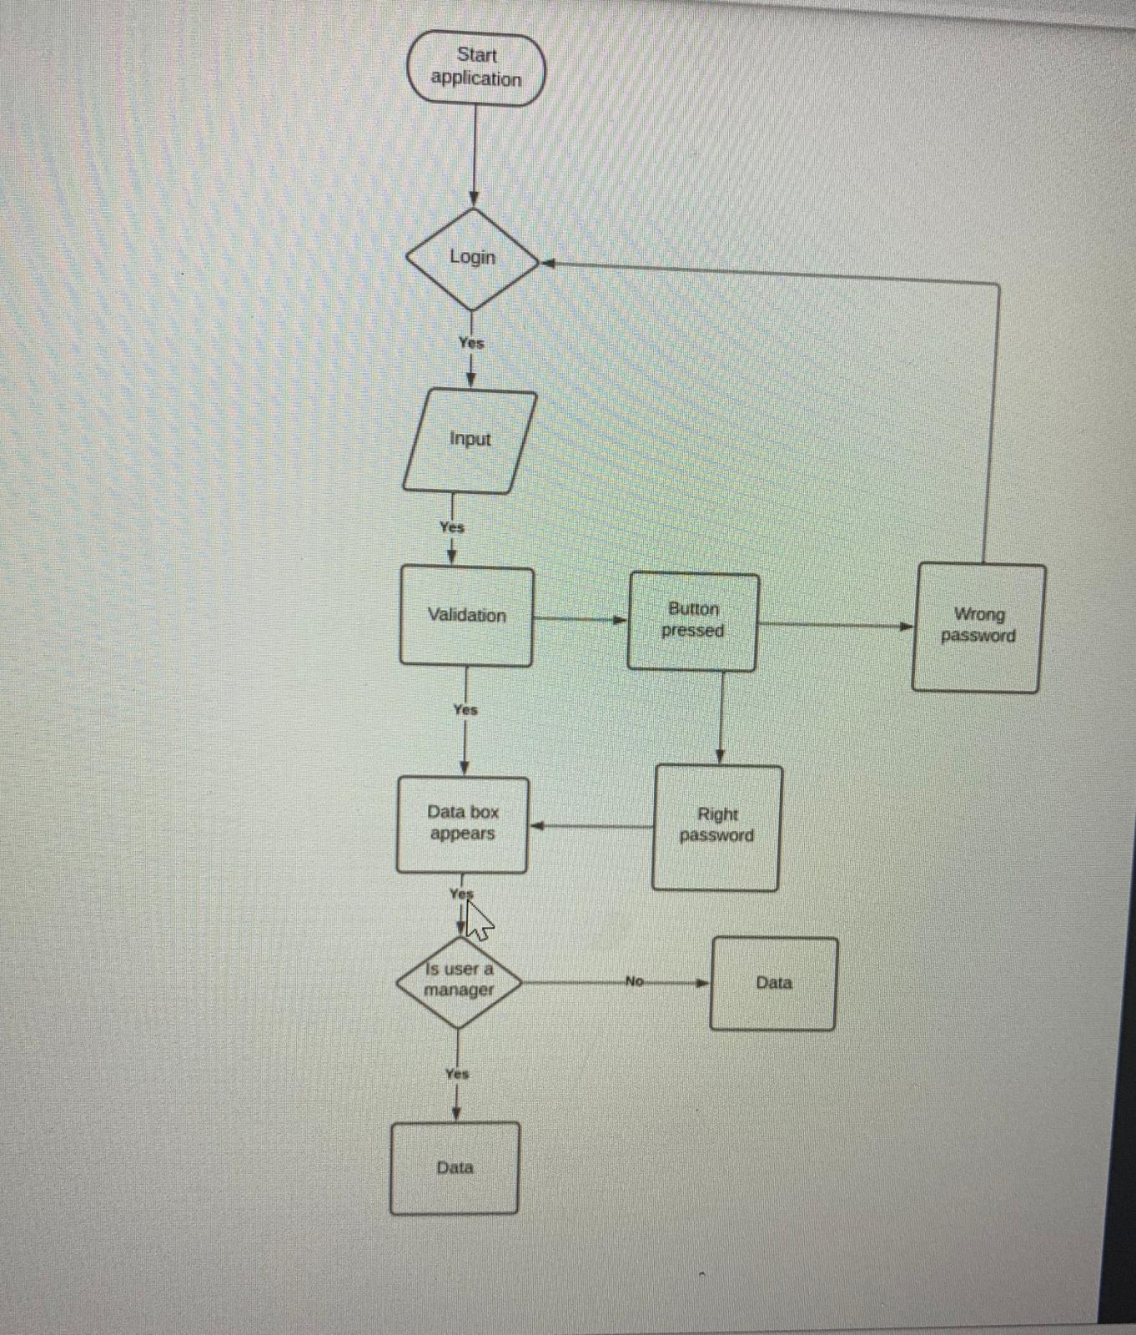
Flowchart – User Verification
Komal

Slide 7
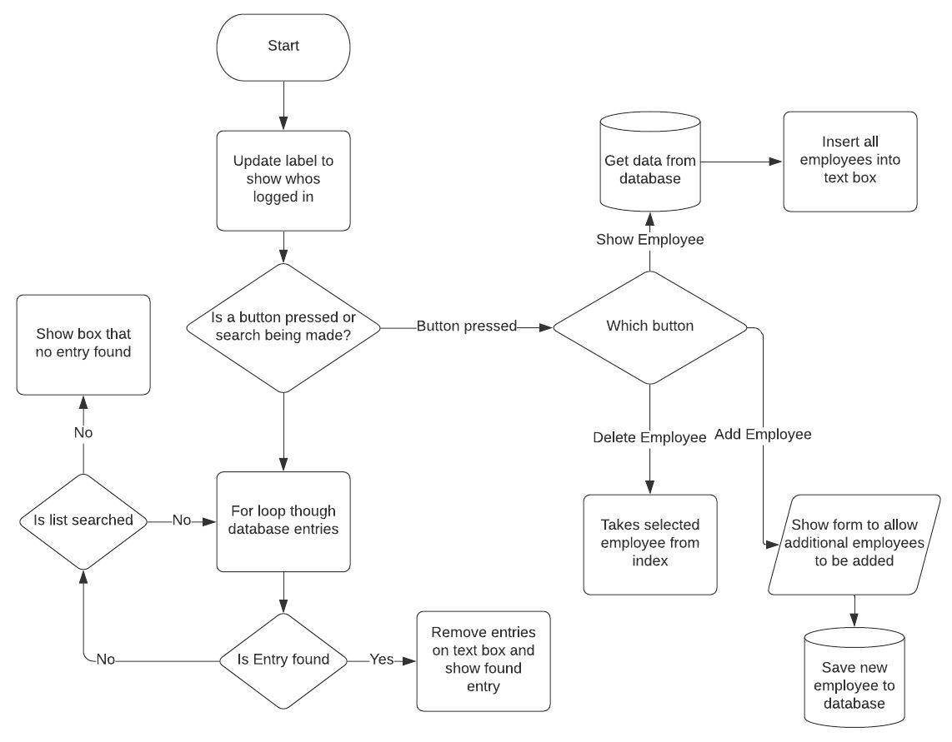
Flowchart – User Interaction
This flowchart shows the decisions and processes that occur post user verification
All buttons presses and searches have been taken into consideration
Taken use of database calls
Jessica Fealy- 18024092

Slide 8
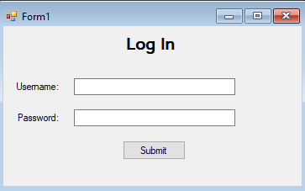
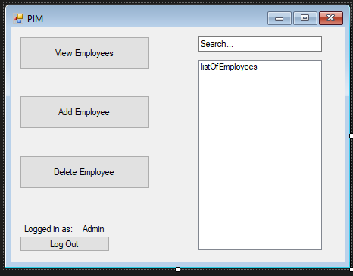
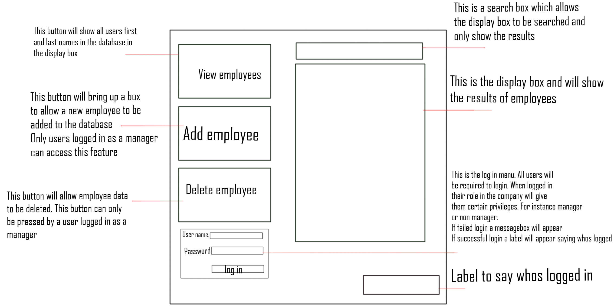
GUI Mock-Up
A GUI Mock-Up was created and annotated by Jessica. We discussed how we wanted the system to be laid out and Jessica visualised it. We used this mock-up to create things like flow diagrams, guide research into Tkinter and SQLite and it helped me design the realistic mock-up in Visual Studio.
I created this realistic mock-up to give our team a better idea of what our program will look like on a computer.
Although our system will be created in Python, I used C# Windows Forms to create this as it was a quick and easy way to visualise our future plans.
Ben Harrison - 18142915
Notes:
An initial GUI Mock-Up was created an annotated by Jess. We discussed in a team meeting how we wanted the system to be laid out, and Jess visualised it. This mock-up helped with the production of the flow diagram, helped guide research into Tkinter and SQLite and it helped me design a more realistic mock-up in Visual Studio.
I created the realistic mock-up to give our team a better idea of what our final PIM System will look like on a computer. Although it was created in C#, not python, we as a team feel like it will help with visualising our future plans.
8

Slide 9
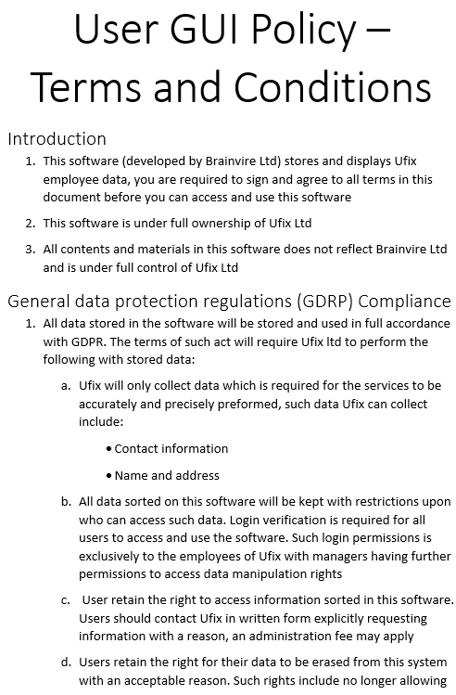
LESPI
The LESPI for this project sets out restricted behaviours and laws all users, regardless of privilege level, must agree and follow
The LESPI highlights key laws such as GDPR and the Computer Misue Act, while also highlighting accessibility and what Ufix are able to do regarding accessibility
In the LESPI also details the allowed uses of this software and the correct methods in which a key and install of this software must come from
Jessica Fealy - 18024092

Slide 10



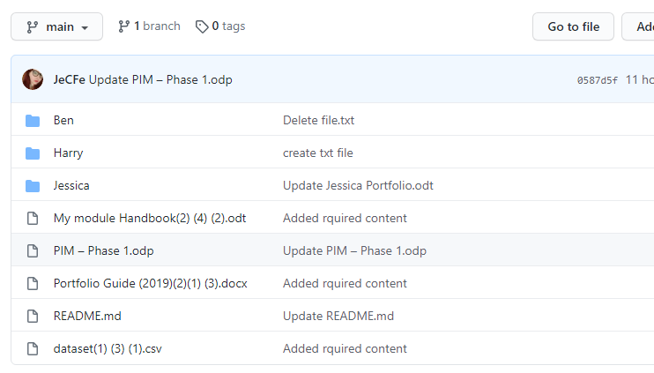
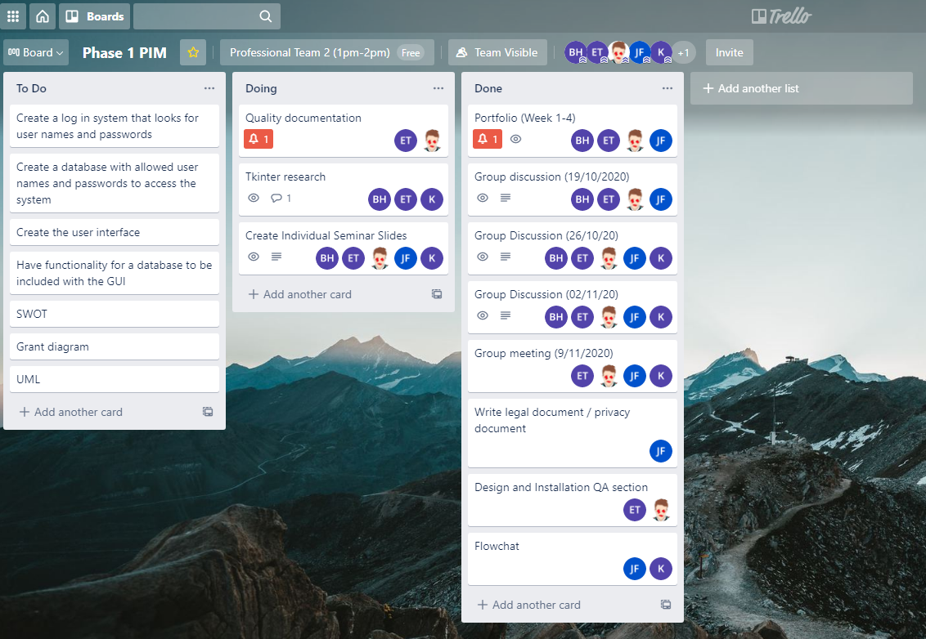
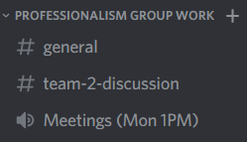
Team Collaboration
Our team has used GitHub as the central for each and every file we individually create. It’s allowed us to seamlessly collaborate without having to fumble around with sending files.
Trello has helped with our groups productivity. We have used a Trello board to monitor what needs to be done and what we have completed.
Discord has been our main form of communication while completing our group project. We have organised weekly meetings to discuss tasks needing to be completed all via Discord.
Ben Harrison - 18142915
Notes:
Team Collaboration
Our team used GitHub as the central hub for every bit of work individually produced. It helped when collaborating as whenever we needed to share work, we just uploaded it directly to the GitHub that everyone has been added to.
Trello has helped with our group’s productivity. Our Trello board was used to monitor what work needs to be completed by who, and what has already been completed.
Discord has been our main form of communication. All of our weekly team meetings has occurred on Discord voice chat.
10

Slide 11
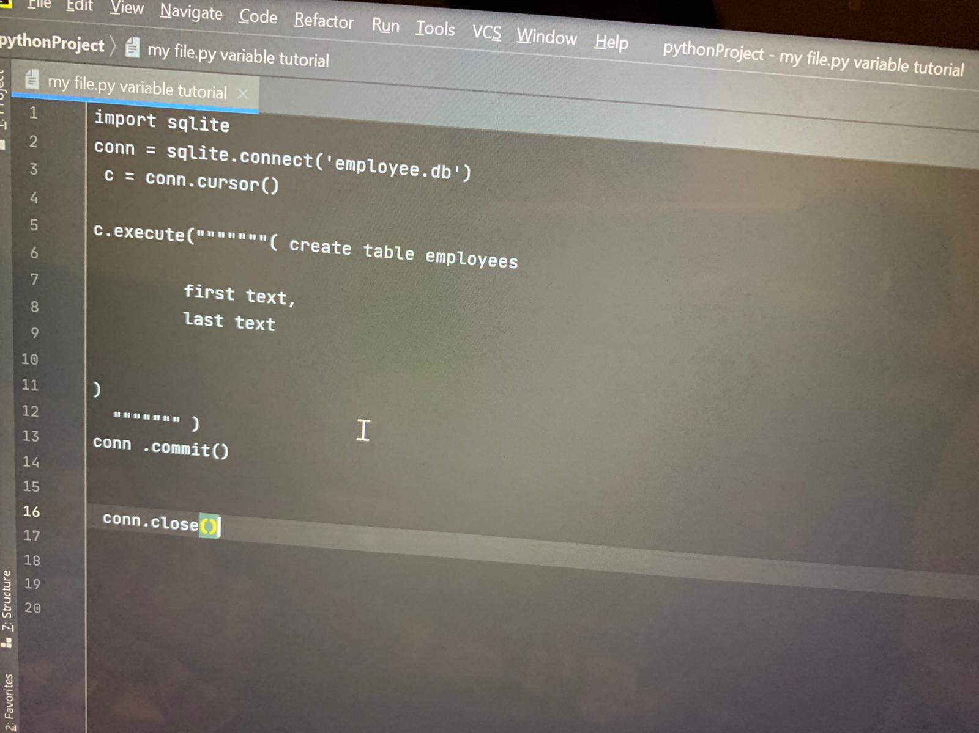
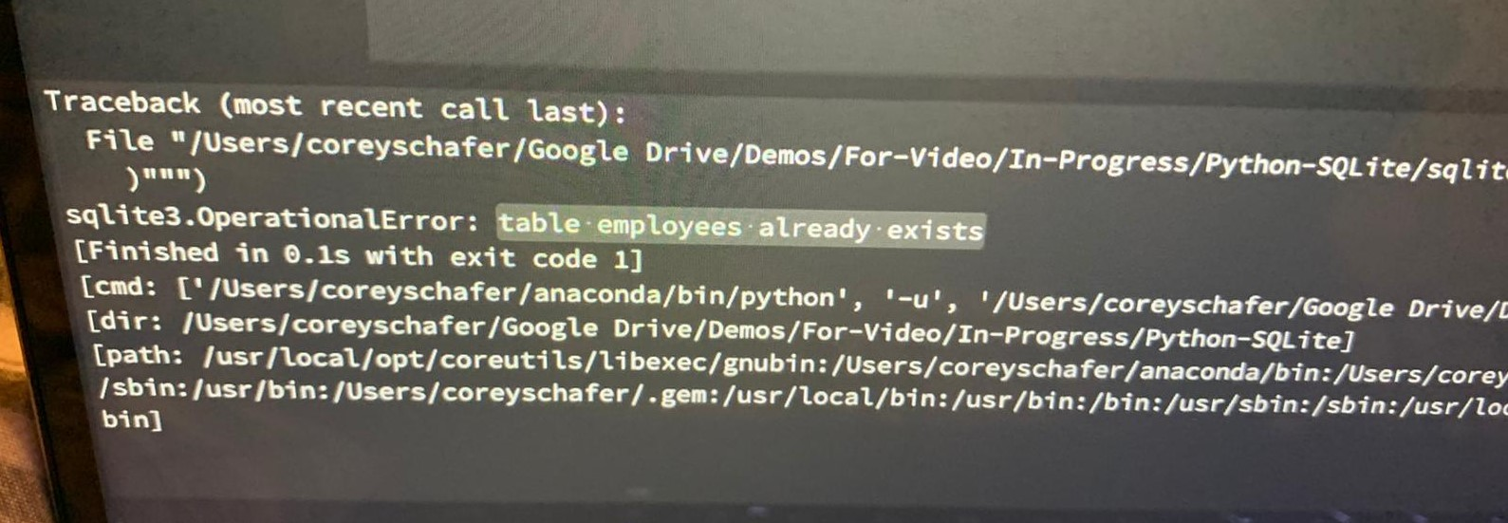
Research – SQLite
I tried to connect PyCharm with SQLlite by adding the SQL server in it .
Then as an example I tried to create an employee table
I tried to add table with the help of SQL.
I found that SQLite has different database.
There are certain classes that I have used:
Null , integer, text , real and dlob.
I commit a changes while using co. Changes and similarly used co. End to end this program .
Komal - 30010813

Slide 12
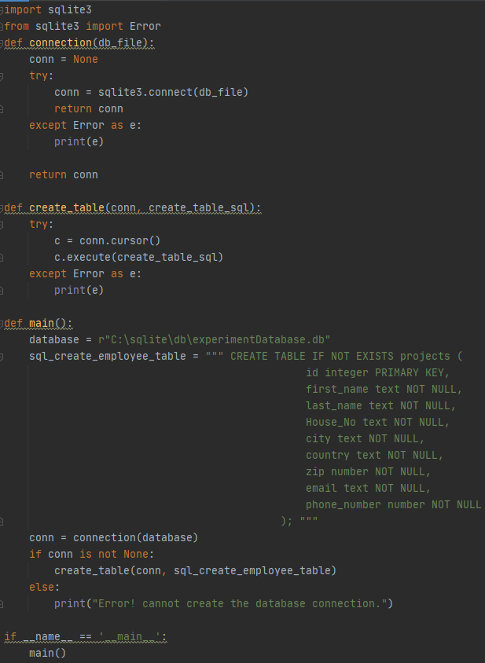
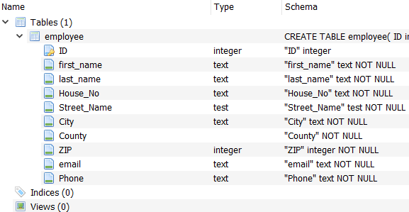
Research – SQLite
While researching SQLite initially at the beginning and intermittently throughout the past few weeks when I had no other work assigned, I focused on getting SQLite to create a database with the table and attributes required for the project.
The final solution should ideally pull data directly from a CVS file, but for initial research practice I preferred to create the database from scratch
Provided is examples of the code used to generate tables and attributes using PyCharm and SQLite browser to view the created database
Jessica Fealy - 18024092

Slide 13
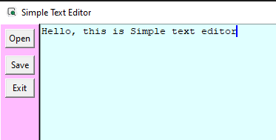
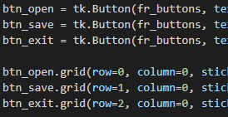
Research - Tkinter
During my time for research on Tkinter library, I made an exercise for myself to make a project as simple text editor with open and save file. This allow me to understand how button works when they trigger by user.
Harry Pearce – 18136044

Slide 14
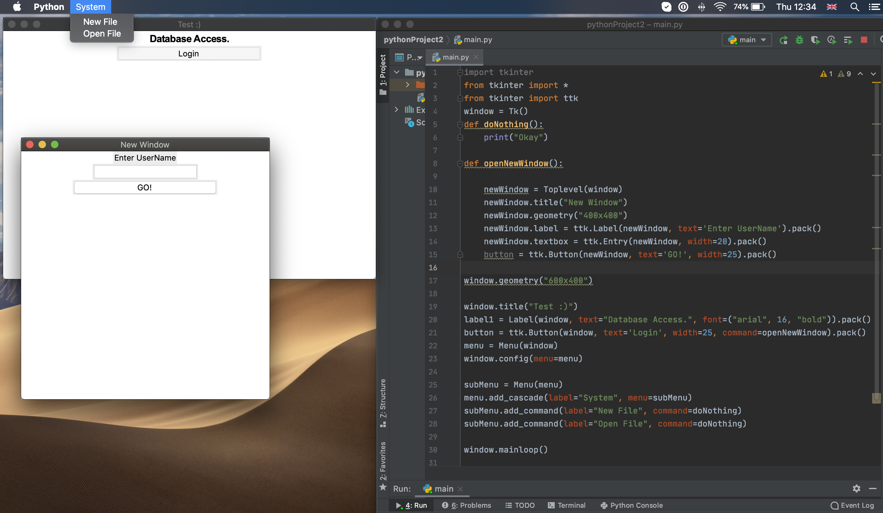
Research - Tkinter
During my research on how tkinter works and how I can develop GUI with python I learned how to create
Creating Labels
Creating Buttons and attach different functions to them
Creating Text boxes and getting the information entered from the user and displaying any information inside the text box
Creating Menu bar with different options and functions.
For my research I used black board materials and online materials and courses.
Eduard Tenev - 18068235

